Slide 1

Slide 1
Ironhack Data Analytics: Mid-bootcamp Project
The significance of pupils’ social background within Germany’s educational system
Luana Ribeiro Matos

Slide 2
Slide 2
Question
Is the social and family background of children decisive for their education opportunities?
Scope of data
Data from Germany with focus on the federal state of Hessen and the city of Frankfurt am Main
Agenda
The school system in Hessen
University students and the level of education of their parents (Germany)
School graduates and their migration background (Hessen)
Secondary school selection and family income (Frankfurt)
Summary
2

Slide 3
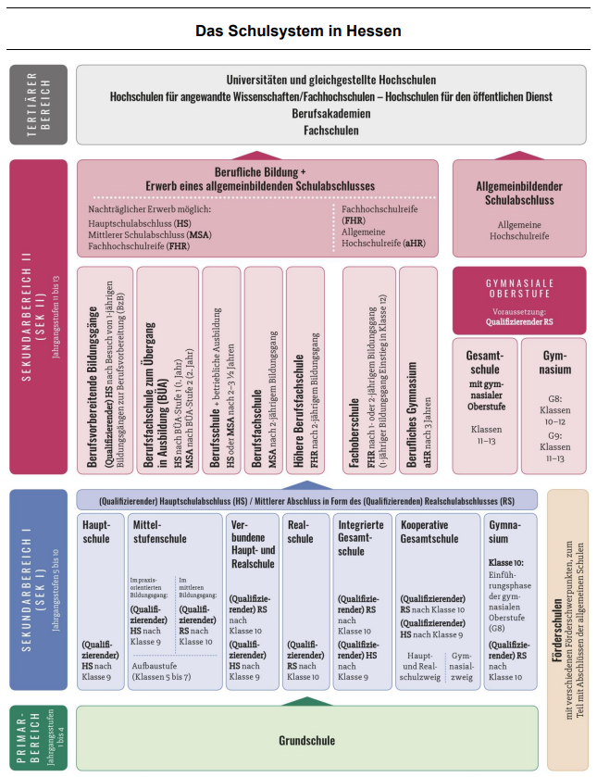


Slide 2
The school system in Hessen
School degree determines professional qualification possibilities
3

Slide 4
Slide 2
The school system in Hessen for dummies
School degree determines professional qualification possibilities
Increasing possibilities for further and higher education
Access to:
vocational trainings
all universities and subjects
Access to:
vocational trainings
subject specific universities after vocational training
Access to:
vocational trainings
High education entrance qualification
(Gymnasium)
Intermediate secondary school
Basic secondary school
Special needs school
Elementary school (Grundschule)
4

Slide 5
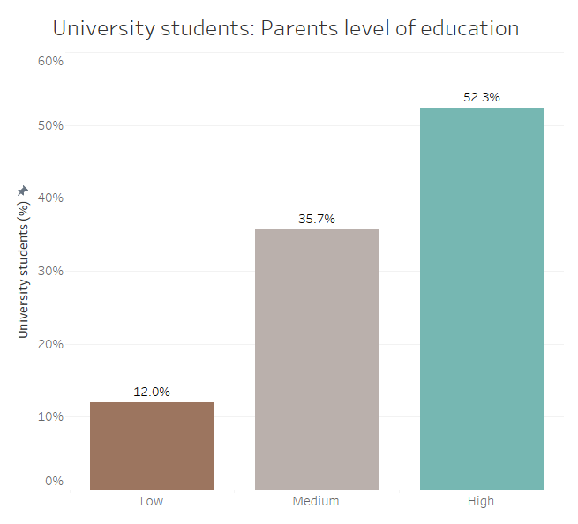
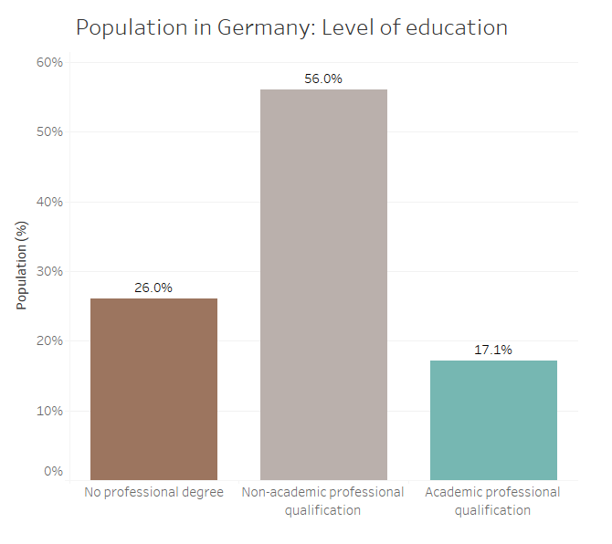
Slide 2
University Students in Germany (2016)
Parents’ level of education
Low:
At least one parent has no professional qualification, and none has academic degree
Medium:
Both parents have non-academic professional qualification
High:
One or both parents have an academic professional qualification
Source: Sozialerhebung 21 (2016)
Source: Statistisches Bundesamt
Data indicates under-representation of population without academic degree amongst university students' parents
5

Slide 6
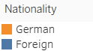
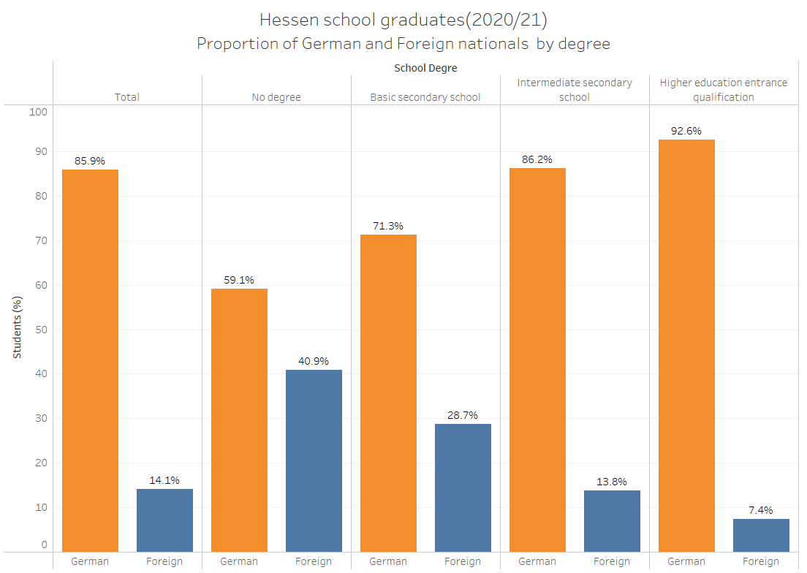
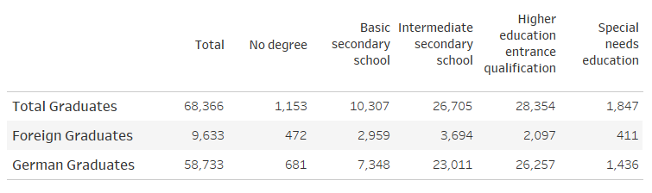
Slide 2
School graduates in Hessen (2020/21)
Migration background
-
+
-
+
further and higher education possibilities
Source: Hessisches Statistisches Landesamt
The smallest proportion of Foreign pupils is found in the school offering the most possibilities for higher education
6

Slide 7
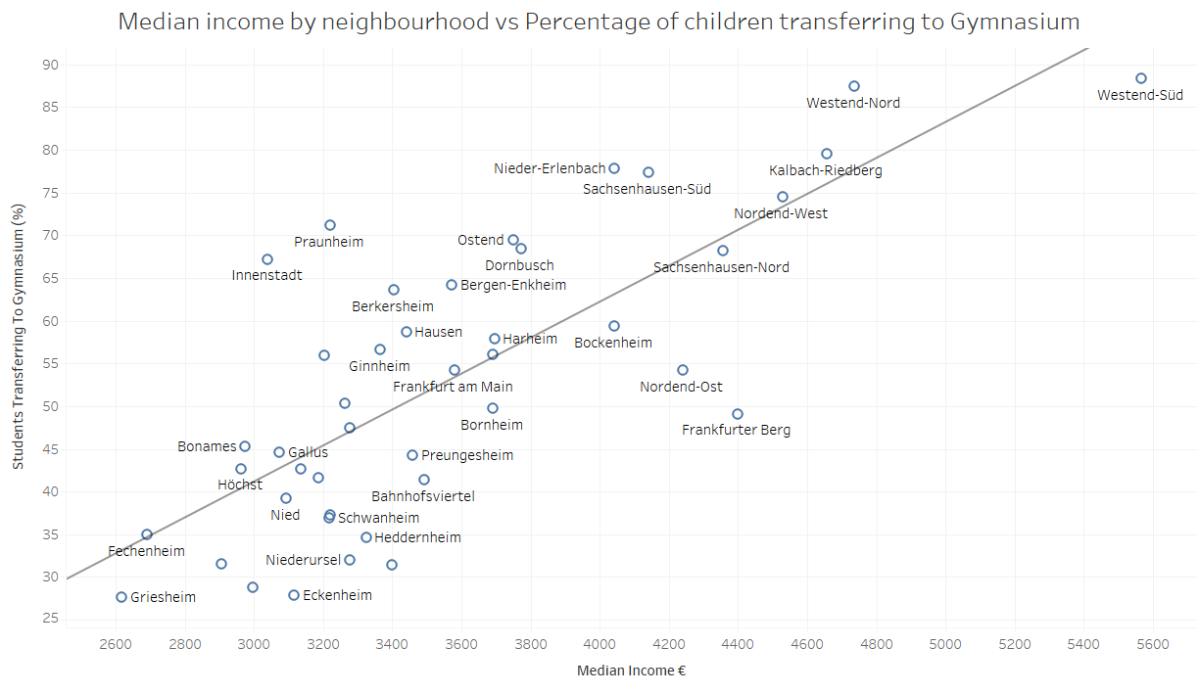
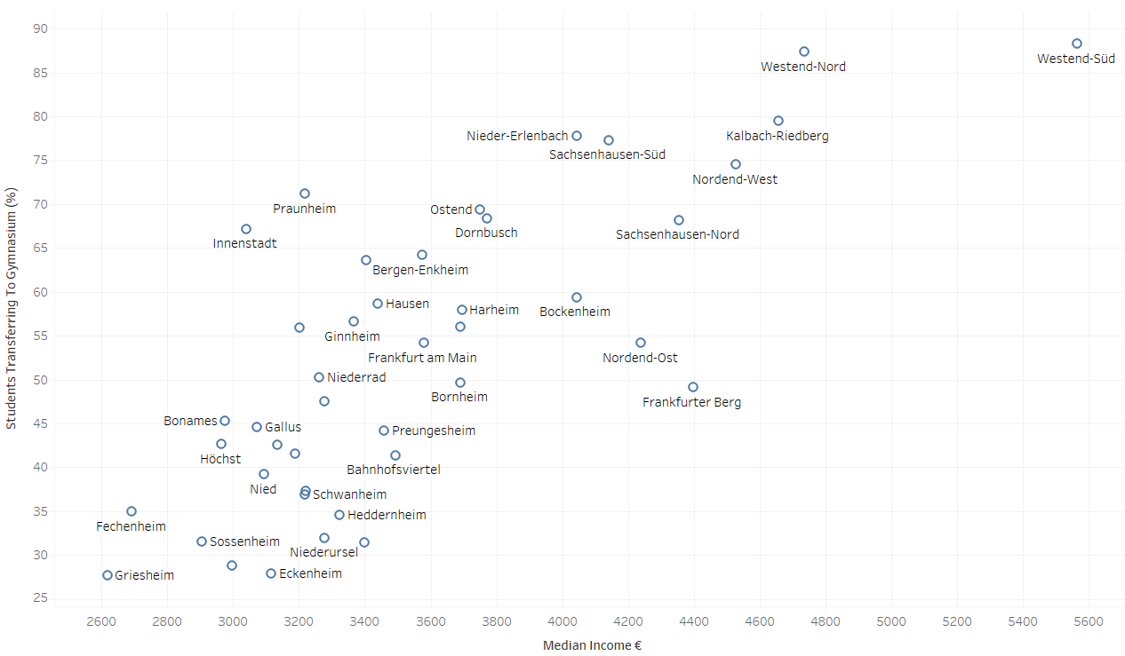
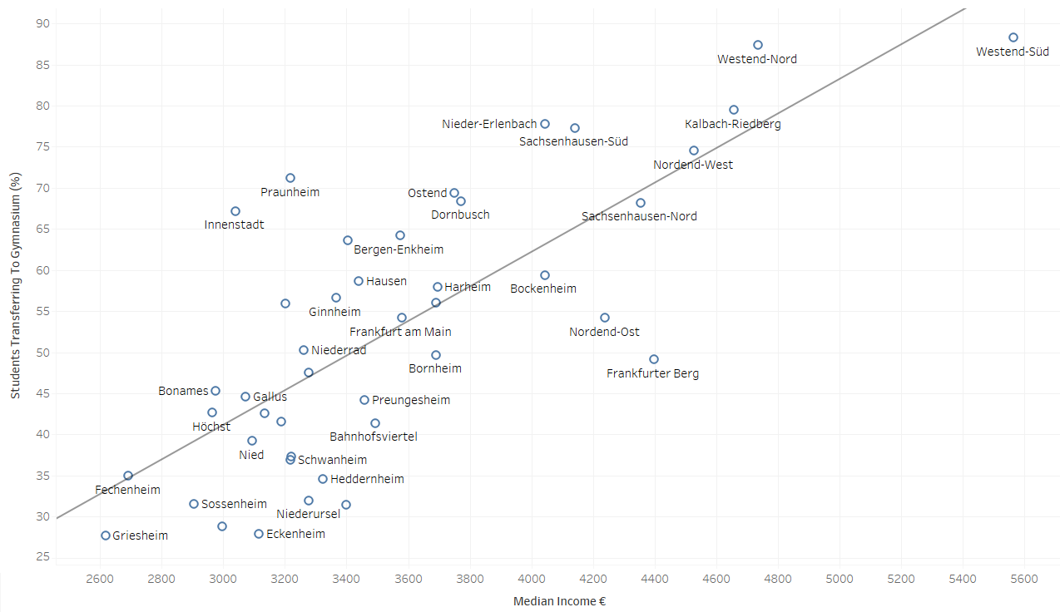
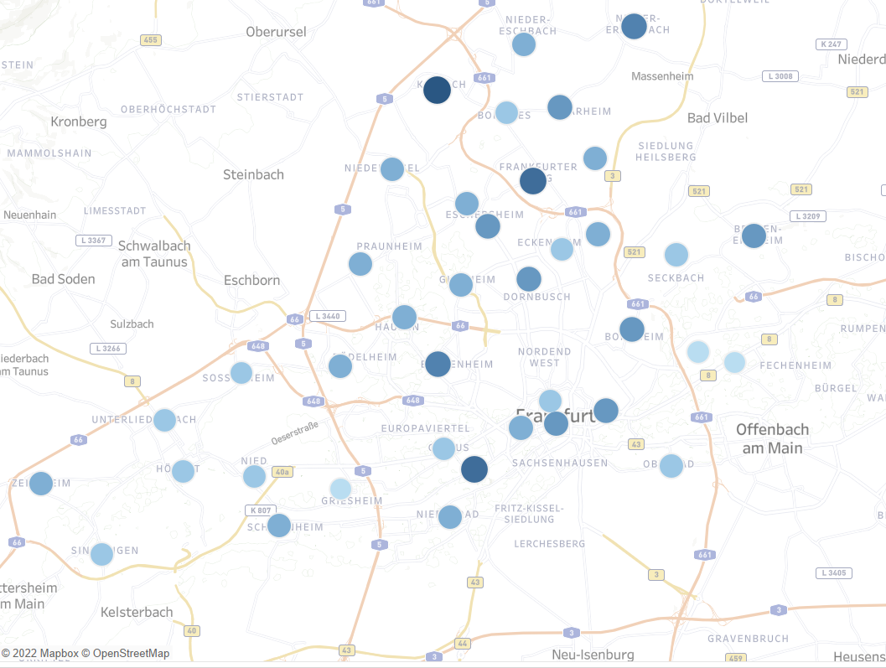
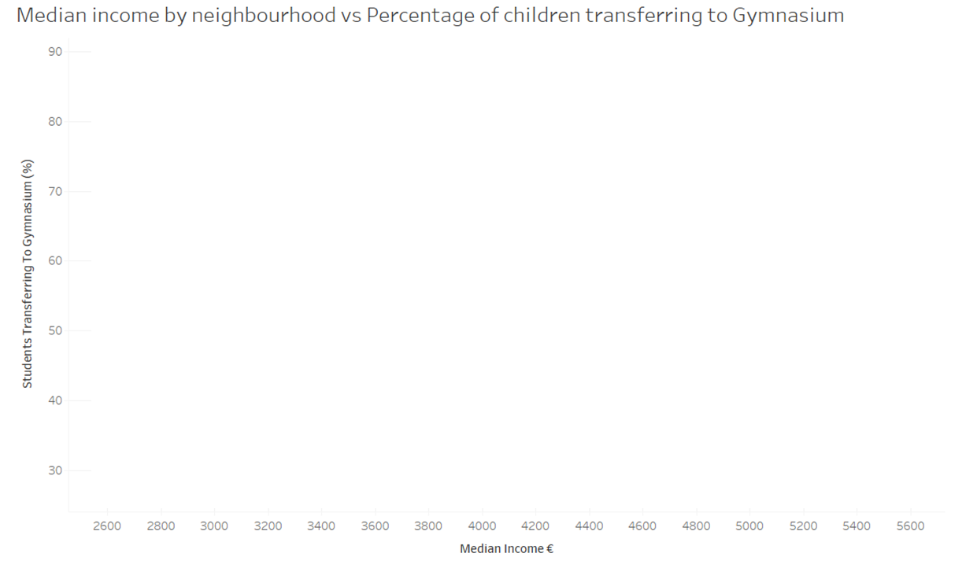
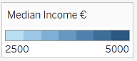
Slide 2
Secondary school selection in Frankfurt (2020/21)
Family income
Students going to Gymnasium
Family income
Source: Strukturdatenatlas Frankfurt
The neighbourhoods with higher median income are likely to have more students transferring to Gymnasium
7

Slide 8

Slide 2
Summary
There is data evidence that the level of education of parents, the migration background and the family income play an important role on the level of education young people are receiving.
A further study with individual data from students would be needed in order to understand which factor has the most impact on the achieved educational degree.
8

Slide 9
Slide 2
Summary
Full project: https://github.com/matosluana/mid_bootcamp_project
Tableau dashboards: https://public.tableau.com/views/Mid-bootcamp-Project/Dashboard1
9

Slide 10
Slide 11
THANK YOU

